Slide 1
PC Maintenance: Preparing for A+ Certification
Chapter 2: Safety and Preventive Maintenance

Slide 2
Chapter 2 Objectives
Identify potential safety hazards when working on PCs
Identify fire extinguisher types
Understand electrostatic discharge
Understand electromagnetic interference
Be able to properly and safely clean a PC
Know how to dispose of hazardous materials

Slide 3
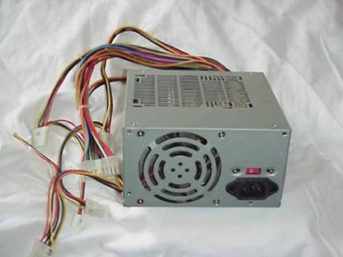
Protect Yourself from Electric Shock
Do not disassemble a power supply
Replace entire power supply if defective

Slide 4
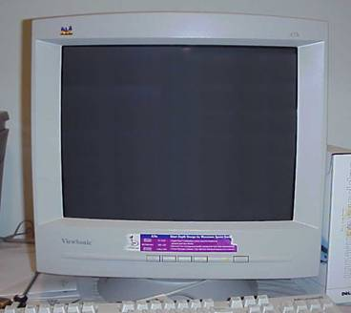
Protect Yourself from Electric Shock
Do not disassemble monitor
Replace entire monitor if defective
Have monitor serviced by specially trained technician

Slide 5
Protect Yourself from Other Hazards
Watch out for
protruding wires
Avoid jewelry of
conductive metals
Inner edges
of cases
may be sharp
Don’t wear
dangling jewelry
Shirt sleeves can
get caught on sharp
edges

Slide 6
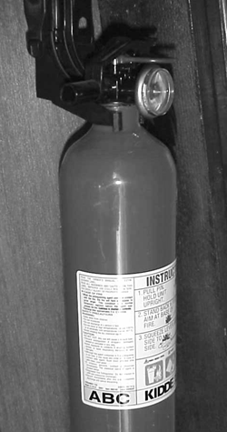
Fire Extinguisher Types
A
Wood and paper
B
Flammable liquid such as gasoline
C
Electrical fires
Read the label!

Slide 7
Electrostatic Discharge
A.k.a. static electricity
Unequal voltage potential between two objects
A very small amount can ruin electronics
Humans feel only large amounts

Slide 8
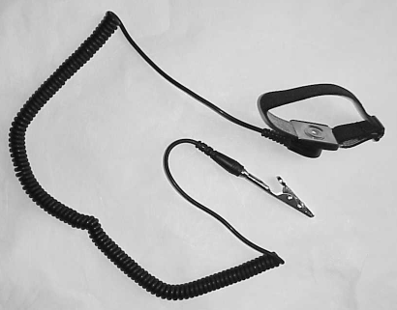
Anti-Static Wrist Strap
Wraps around your wrist
Clips to ground plug or metal frame of PC case

Slide 9
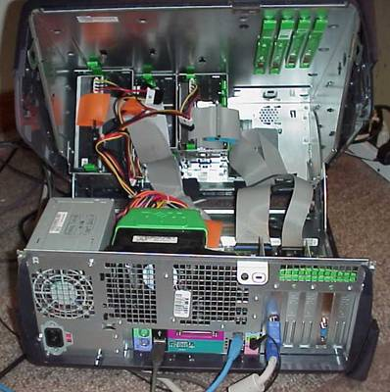
Equalize the Potential
Touch metal frame of PC before touching circuit board or chip

Slide 10
Avoiding ESD in Environment
Work in a room with humidity between 50% and 80%
Wear natural fibers, not synthetic
Wear rubber-soled shoes when possible
Stand on a ESD-dispersing floor mat if available

Slide 11
Electromagnetic Interference (EMI)
Electricity passing through cable generates a magnetic field.
Magnetic field can interfere with data passing through nearby cables, causing data corruption

Slide 12
Preventing EMI
Use EMI-shielded cables in areas where it is an issue
Use short cables when possible
Move cables so they don’t run together
Relocate the PC to a different location

Slide 13
Other PC Hazards
Temperature: PCs prefer cool areas, but keep above freezing
Trauma: Don’t place PCs where they can be kicked or knocked off
Magnets: Magnets can ruin data stored on a disk. Magnets may be found in speakers and in some older phones, as well as magnetic tools

Slide 14
Cleaning Supplies for a PC
Spray cleaner designed for external computer parts
Vacuum designed for electronics
Denatured alcohol
Cotton swabs
Clean dry lint-free cloths
Can of compressed air

Slide 15


Cleaning a Monitor
Do not use regular glass cleaner
Use glass cleaner designed for monitors
Do not spray while monitor is turned on

Slide 16
Cleaning a Keyboard
Turn off the PC before cleaning keyboard
Turn keyboard upside-down and shake gently to remove loose particles
Get between the cracks with a cotton swab or a bit of folded paper towel
Clean keys with a cloth dampened with spray cleaner designed for PCs

Slide 17
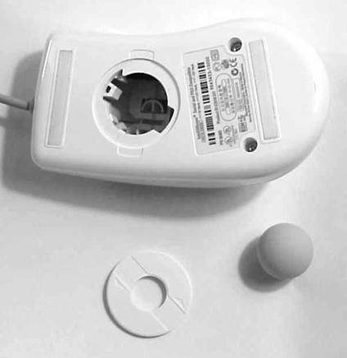
Cleaning a Mouse
Remove panel on the bottom
Remove the ball
Clean inside with alcohol and cotton swab
Clean ball with soap and water

Slide 18
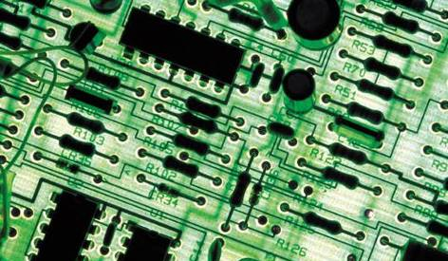
Cleaning Circuit Boards
Use canned air to blow dust away
Do not use water
Use alcohol if liquid is necessary

Slide 19
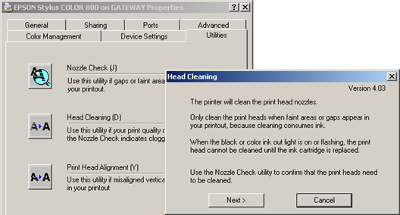
Cleaning an Inkjet Printer
Clean the outside with a cloth dampened with cleaner for PCs
Run the printer’s self-cleaning utility to clean print heads

Slide 20
Cleaning a Laser Printer
Clean corona wires with alcohol and cotton swabs
Clean outside with cloth dampened with PC cleaner
Vacuum loose toner with special vacuum for electronics

Slide 21
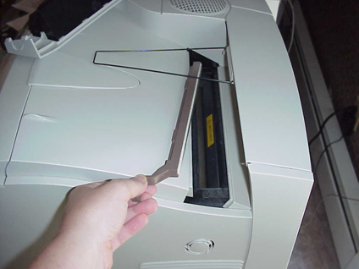
Cleaning Pad on Laser Printer
Replace felt pad when replacing toner if your model uses one
Replacement pad will come with toner cartridge if needed

Slide 22

Disposal of Hazardous Materials
Make use of your local hazardous waste disposal facility
  Cleaning chemicals
  Toner cartridges
  Monitors
  Circuit boards
  Batteries

Slide 23

Material Safety Data Sheet (MSDS)
Guidelines that dictate proper disposal of an item
Available on the Internet, or through EPA

